Slide 1
Sumanth S Hegde (4JN19MCA78) Vijay Kumar (4JN19MCA81)
Pedestrian Detection using OpenCV
Presented by :

Slide 2
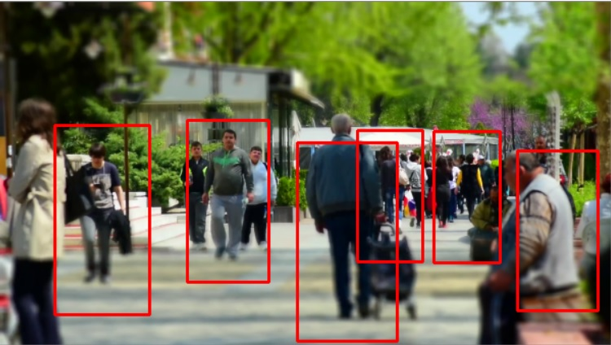
Overview
The main aim of this project is to detect the visible pedestrians in a video and locating all instances of human beings present in the video, and it has been most widely accomplished by searching all locations in the video.

Slide 3
Introduction
OpenCV:
OpenCV (Open Source Computer Vision Library) is an open source computer vision and machine learning software library. OpenCV was built to provide a common infrastructure for computer vision applications and to accelerate the use of machine perception in the commercial products. OpenCV-Python is a library of Python bindings designed to solve computer vision problems.

Slide 4
Introduction
Pedestrian Detection:
Pedestrian detection is the task of locating all instances of human beings present in an image or video, and it has been most widely accomplished by searching all locations in the image or video, at all possible scales, and comparing a small area at each location with known templates or patterns of people.

Slide 5
Introduction
File System:
A file system controls how data is stored and retrieved. Without a file system, data placed in a storage medium would be one large body of data with no way to tell where one block of data stops and next begins. By separating the data into blocks and giving each block a name, the data is easily divided and identified.

Slide 6
Modules
User Input
System Process

Slide 7
Modules
User Input:
A file system controls how data is stored and retrieved. Without a file system, data placed in a storage medium would be one large body of data with no way to tell where one block of data stops and next begins. By separating the data into blocks and giving each block a name, the data is easily divided and identified.

Slide 8
Modules
System Process:
OpenCV has a built-in method to detect pedestrians. It has a pre-trained HOG (Histogram of Oriented Gradients) + Linear SVM model to detect pedestrians in images and video streams. It checks the surrounding pixels of every single pixel. The goal is to check how darker is the current pixel compared to the surrounding pixels. The algorithm draws and arrows showing the direction of the image getting darker. It repeats the process for each and every pixel in the image. At last, every pixel would be replaced by an arrow, these arrows are called Gradients. These gradients show the flow of light from light to dark, thus detecting pedestrians.

Slide 9


System Requirements
Hardware Requirement
Software Requirement
Processor : Intel i3 or higher
Hard Disk : 10 GB
Input Devices: Keyboard, mouse
Ram : 4 GB
Language : Python
Platform : Windows 7/8/10
IDE : Python IDLE, Jupyter Notebook.

Slide 10
DFD :
System
Choose the correct directory
Provides list directories to choose
user
needs to
Select the video file from the directory
Video File selected
using HOG
descriptor
Indicates the pedestrians and displays as an output
Exit
If file not
found or
after
selecting
system compares
dark pixels
Invalid choice
User
User

Slide 11
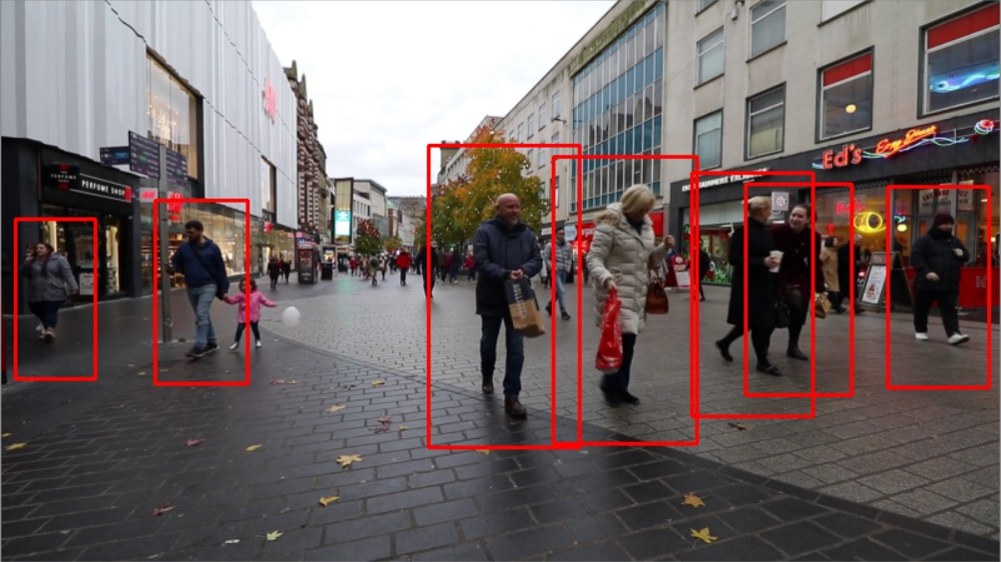
Future Enhancements
This project can be implemented for image also.
In the future it can be developed to provide advance driver assistance.
Pedestrian Detection system in Traffic Surveillance.

Slide 12
Conclusion
This project is successful in detecting pedestrians in a given video.
While developing this project we gained knowledge on OpenCV, HOG Descriptor.
The main topics are described on chapter four, where the pedestrian detection technique is being specified. This is implemented using python programming language and using a recorded video from a camera or from a surveillance system.

Slide 13
References
https://www.geeksforgeeks.org/opencv-python-tutorial/
https://www.pyimagesearch.com/2015/11/16/hog-detectmultiscale-parameters-explained/
https://opencv.org/
Programming Python: Powerful Object-Oriented Programming by Mark Lutz.
Learning OpenCV 4 Computer Vision with Python 3 by Joe Minichino and Joseph Howse.

Slide 14
Thank You

